Slide 1

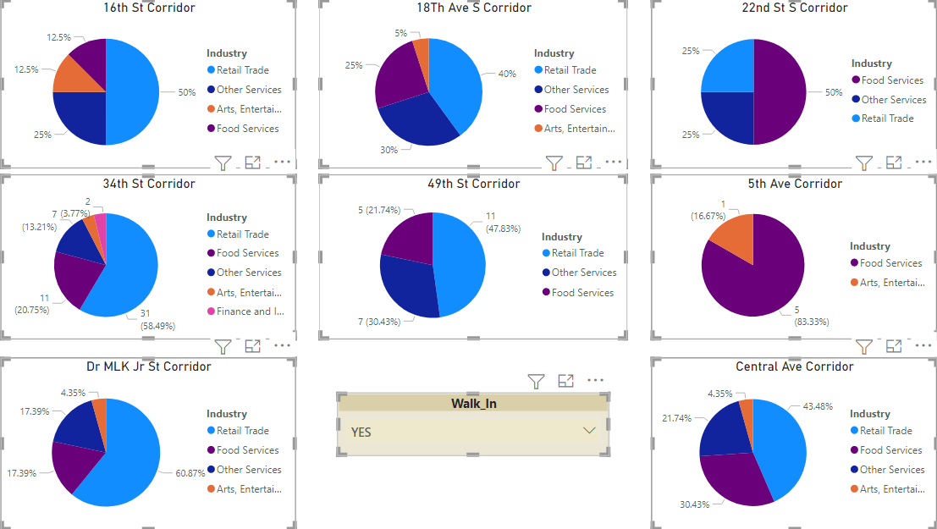
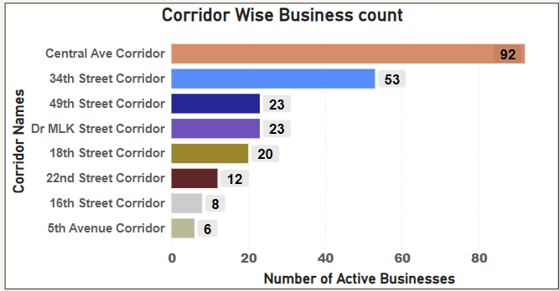
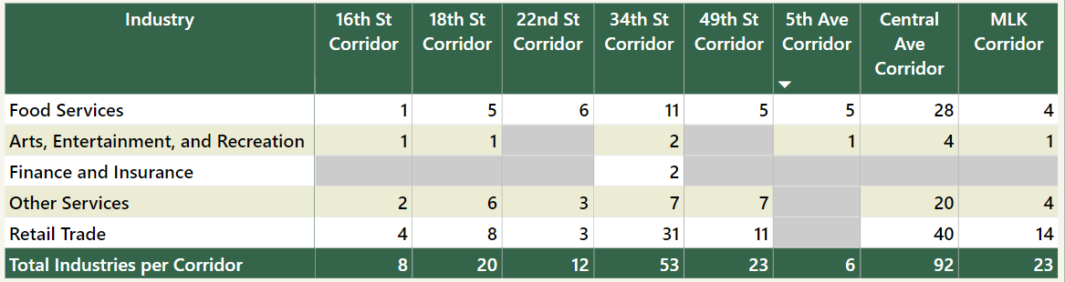
The retail sector is well-established in all the areas except for 5th Ave, where it is absent. According to the analysis, the retail industry is flourishing in most of the corridors.
The retail sector is well-established in all the areas except for 5th Ave, where it is absent. According to the analysis, the retail industry is flourishing in most of the corridors.
Customer Flow: Corridors of St Petersburg 2023
Abhijeet Sharma ,Sravani Peddamallu, N.V. S. Naveen, P. Shanmukh,
K.P. Akshay Kumar
Introduction
Methodology
Based on the processed data, it can be concluded that most businesses are in the Central Avenue Corridor, followed by the 34th Street Corridor and the 49th Street Corridor. This information can be used to understand the concentration of businesses in different areas and to make informed decisions about business development and investment.
Central Ave corridor boasts of around 92 industries with retail trade industry having the highest share followed by Food Services, other services, and Arts, Entertainment, and recreation, making it a diverse and dynamic commercial hub catering to various consumer needs
The 5th Avenue corridor is limited to only two industries, with a strong focus on food services and arts, entertainment, and recreation, with food services being the dominant sector.
The purpose of this project is to conduct an analysis of the foot traffic in various businesses located on commercial corridors within the South St. Petersburg Community Redevelopment Area, using data from the City of St. Petersburg's Business Tax ID records for the year 2023. The objective is to categorize the businesses based on the number of walk-ins they receive and provide valuable insights to stakeholders such as policymakers, entrepreneurs, and financiers.
The findings of this study will have significant implications for the stakeholders operating within the locality. Policymakers can use the insights to create policies that promote the growth and sustainability of businesses. Entrepreneurs can make informed decisions about expanding their enterprises and managing challenges effectively. Investors can utilize the data to make well-informed investment decisions in the area.
Overall, this project aims to contribute to establishing a favorable commercial environment in St. Petersburg, Florida, and fostering economic development in the locality.
In accordance with the given instructions, a filtering process has been carried out to extract unique values from the 'PIN #' column, ensuring that there are no duplicate values in the dataset
.
To focus on businesses that have a walk-in facility, a filter has been applied to the 'Walk-in's' column. This filter has been set to only include businesses that offer walk-in services, allowing us to narrow down the data to those companies that are of interest to our analysis.
Results
Figure2:Analyzing various businesses operating in different corridors
Figure2:Businesses Distribution across corridors
Figure 1:Business Split Across Corridors
Conclusions
Research Question
The Retail sector is well-established in all the areas except for 5th Ave, where it is absent. According to the analysis, the retail industry is flourishing in most of the corridors.
The food industry is found everywhere and seems to be doing well in each corridor, indicating that it is a dependable and robust business in all corridors.
The arts and entertainment industry is not well-represented in any of the corridors, and it is completely absent in the 22nd St S and 49th St Corridors. This industry requires significant support to improve and become successful in these areas.
The services industry has a negligible presence in the 5th Ave Corridor, accounting for only 13.21% to 30.43% of the businesses present, which is significantly lower than the proportion of other industries in the area.
The retail trade industry has the highest number of walk-ins in nearly all corridors in which it exists, whereas the food services industry has a respectable occupancy rate in every corridor.
There are approximately 92 industries with walk-ins along the Central Avenue Corridor, and the retail trade industry has the greatest percentage of occupancy in it.
The application of filters has significantly reduced the number of records, leaving us with a more manageable dataset containing 1270 records that meet the criteria set by the filters.
In order to conduct a thorough analysis of businesses operating in multiple corridors, we have taken a granular approach by considering each corridor individually. To do this, we have counted the number of businesses that operate in each corridor and then added these counts back to the original corridors. By doing so, we can get a more nuanced understanding of the distribution and impact of businesses across multiple corridors.
Analyze and compare corridor trends related to "walk-in” retail businesses in 2023.
What percent of businesses on each commercial corridors might be considered “walk-in” retail businesses (e.g., shopping, restaurants, entertainment, etc.)?
References
Power BI Report. (n.d.). [Report section title]. Power BI
Group: me. Retrieved from
https://app.powerbi.com/groups/5a9f0b72-6638-437d-afa2-8eeab81c835b/reports/da1ebe5d-f799-4957-bbb5-788afd796633/ReportSection
Comparative ranking: Which corridors have the most “walk-in” retail businesses?

